Slide 2
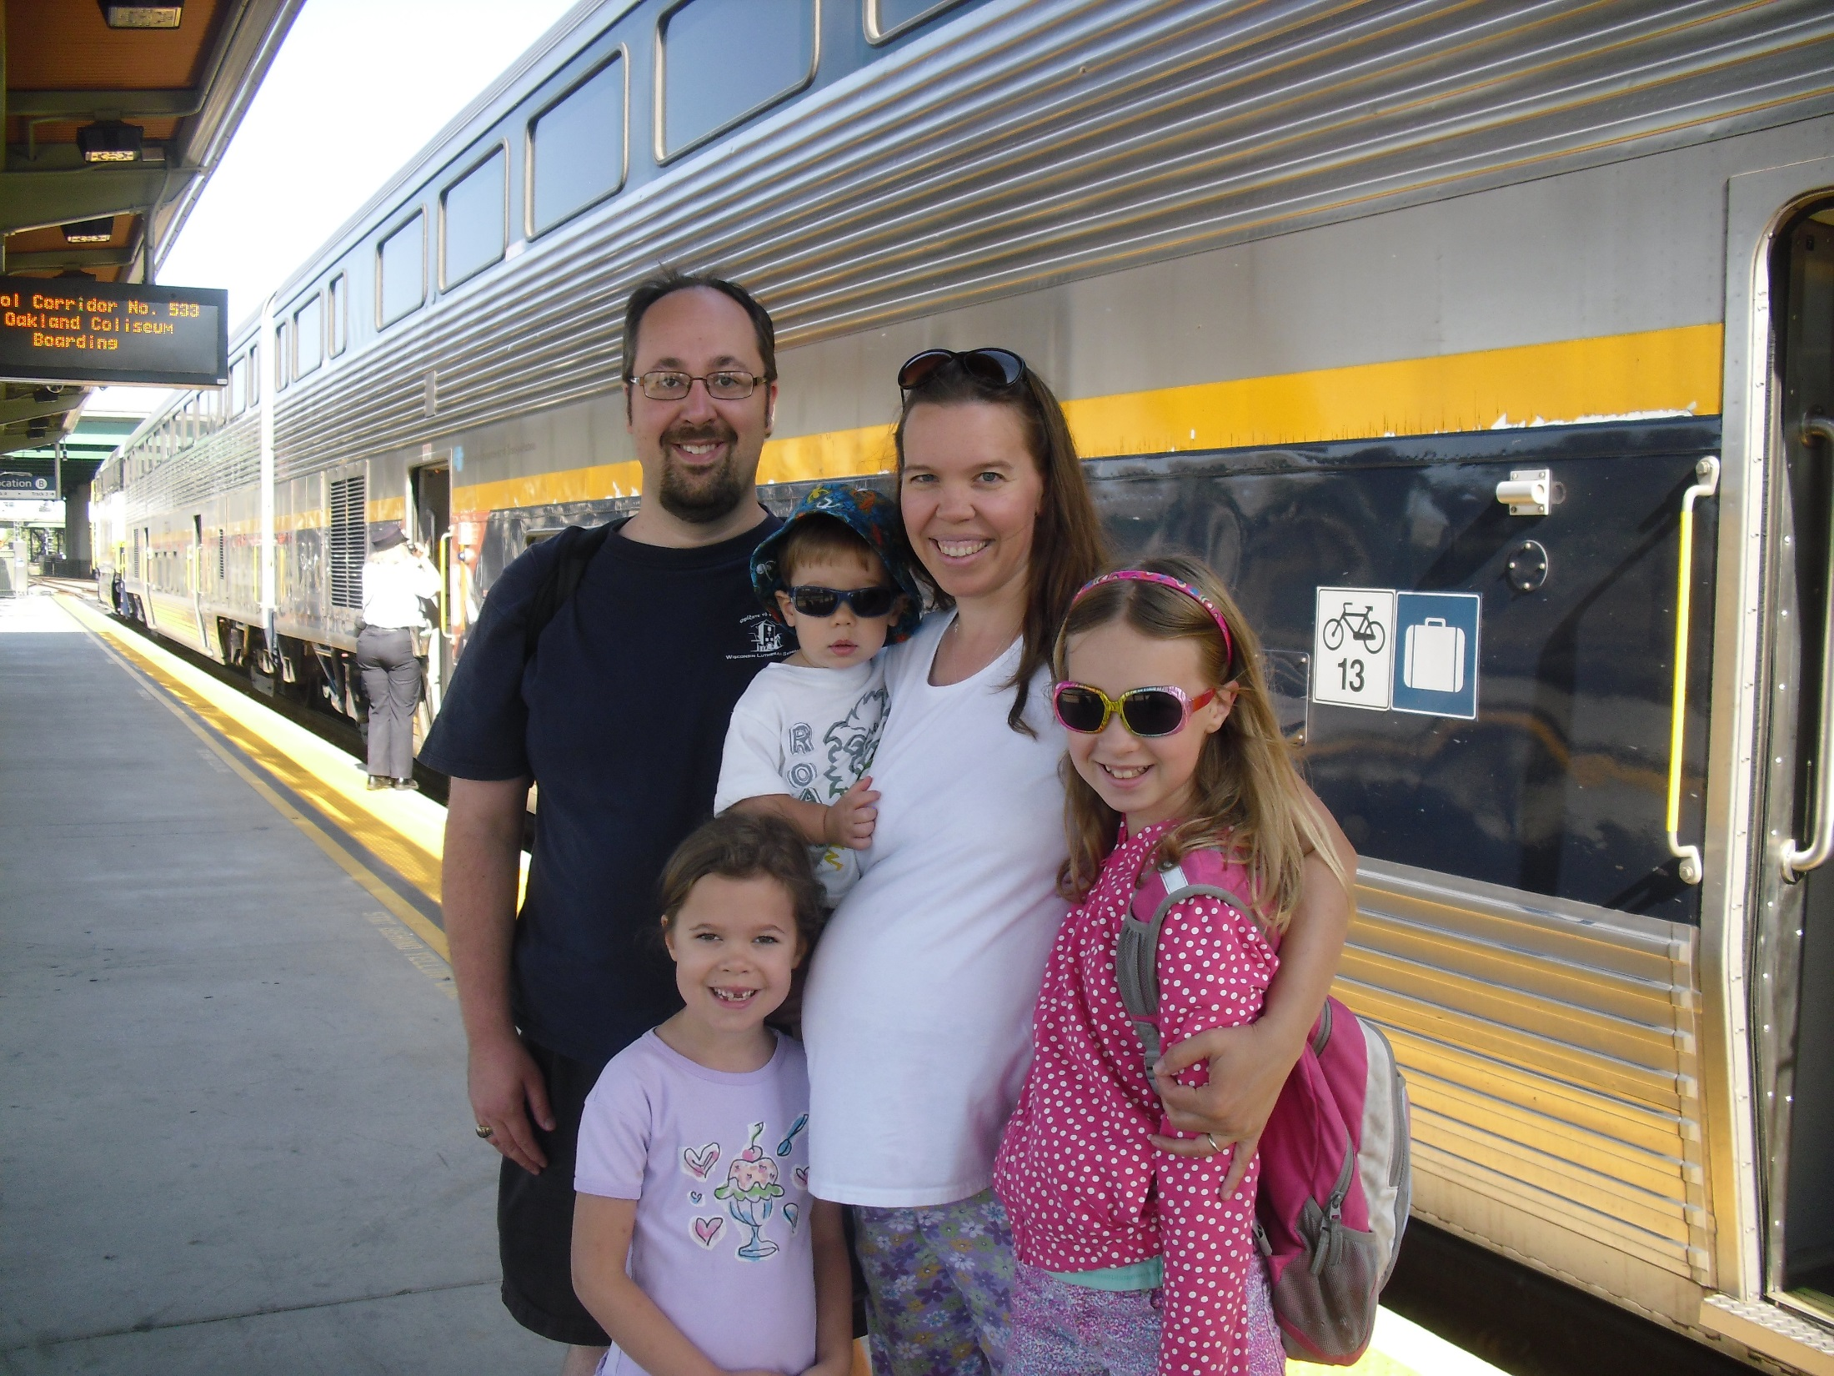

Slide 3
Enhancing the Liturgical Year
WELS National Conference on Worship, Music, and the Arts

Slide 4
Presuppositions
Worship forms communicate what we believe
Baptist altar call
Roman Catholic genuflecting toward tabernacle
Lutheran Word-and-Sacrament service
Communication takes place with more than words
Social science research tells us that as much as 80% of communication is non-verbal
Younger generations and many minority cultures tend to be more tactile and visual
Ceremony is an important part of our lives, though we don’t often realize it
Worship is not only remembrance but also anamnesis
Remembrance: Recalling the past. History? Nostalgia?
Anamnesis: We recall the past in a “living way” today

Slide 6
General Suggestions
CHURCH ART
Purchase paraments of high quality and in substantial sizes
Purchase or prepare seasonal banners and tapestries of high quality

Slide 7
General Suggestions
SEASONS & SUNDAYS
Design and prepare service folders that reflect the changing seasons
Use the Psalm of the day and the Verse of the Day

Slide 8
General Suggestions
SEASONS & SUNDAYS
Select seasonal distribution hymns
Make sure of seasonal emphases in the Prayer of the Church
CW: Altar Book
LCMS’s “Let Us Pray”
Preach in a way that reflects the integrity of the various seasons
Carefully compare traditions of short and long experience in the church
PRAYER OF THE CHURCH
M: Dear Father in heaven, with your gift of a Savior you restored hope for our fallen world and brought glory to your name. We thank you for the good news that you have reconciled the world to yourself through your Son.
C: Be with us as you give us opportunities to proclaim your glorious name of salvation in Jesus Christ our Savior.

Slide 9
Advent Preparation
ADVENT SUNDAY THEMES
Week 1: Readiness
Week 2: Repentance
Week 3: Rejoicing
Week 4: This Sunday transitions from a focus on the Second Advent of Christ to a focus on his First Advent, i.e. his birth

Slide 10
Advent Preparation
Advent is not yet Christmas! Be a refuge from the secular world!
Advent gathering rites
Advent wreath
Midweek Advent services – yes or no?
Service of Lessons and Carols (CW:OS)

Slide 11
Christmas: Celebrate the Incarnation
CHRISTMAS EVE OBJECTIVES
Early family service
Late outreach/adult service
Nine Lessons & Carols (CW:OS)
OBSERVE CHRISTMAS DAY
The festival of the Nativity
Include the Sacrament
Confession of faith: Second Portion of Athanasian Creed

Slide 12
Epiphany: Christ Is Revealed as God
EPIPHANY DAY – Jan. 6
The forgotten festival
Midweek service? Second Sunday after Christmas?
Plan a retreat or Bible Class series reviewing world mission work

Slide 13
Epiphany: Christ Is Revealed as God
FIRST SUNDAY: Jesus’ Baptism
Remembrance of Baptism (CW:OS)
MIDDLE SUNDAYS:
Second Sunday’s Gospel from John
Other Sunday’s Gospel from Synoptics
Year A – Matthew – Preaching (Sermon on the Mount)
Year B – Mark – Miracles
Year C – Luke – Teaching
LAST SUNDAY: Jesus’ Transfiguration
Always observed regardless of season’s length
Preparatory for Lent
Farewell to Alleluia (CW:OS)

Slide 14
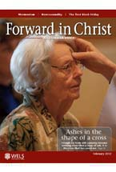
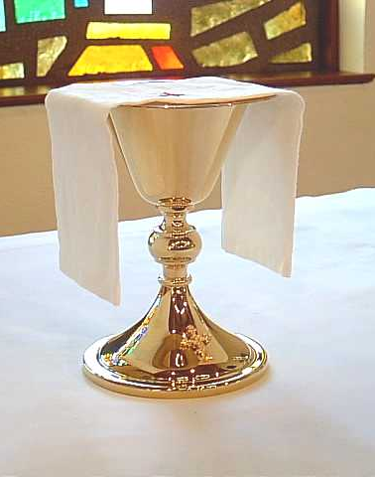
Ash Wednesday & Repentance
Ash Wednesday is distinct from other midweek Lent services
Services in CW:OS
Imposition of Ashes
Corporate Confession and Absolution
Liturgical color: Black
Inclusion of the Sacrament?

Slide 15
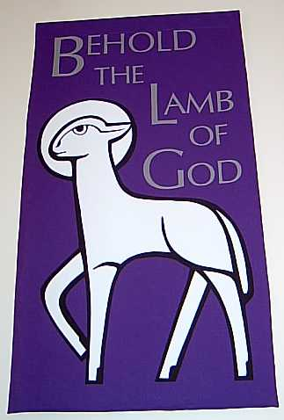
Lent: Christ in Conflict
Focus
Sundays: Christ confronts his enemies and ours
Midweek: Passion history
Orders of Worship
Sunday: Gathering Rite
Midweek: Prayer at the Close of Day (CW:OS)
Celebrating with muted joy
Omit alleluias, Song of Praise
A somber Lenten season intensifies the joy of Easter

Slide 16
Holy Week: The High Point of the Church Year
PALM SUNDAY
Procession with Palms (CW:OS) with the entire assembly or a selected group (school children)?
Sunday of the Passion (an option particularly useful where there are no midweek Lent services)
MAUNDY THURSDAY
Highlight the Institution of the Sacrament
Stripping of the Altar at the conclusion (CW:OS)
GOOD FRIDAY (CW:OS)
Service of the Cross
Service of Seven Words
Service of Darkness
EASTER EVE
Vigil of Easter (CW:OS)
Logistics and details are important!
Key transitional moment of the church year

Slide 17
Easter: Christ Is Risen!
Note two sets of Propers: Easter Dawn and Easter Day
Include the Sacrament in a service not intended for outreach (Vigil, Sunrise)
“This Is the Feast” (CW #265) replaces the major Song of Praise this season
Other settings are available
CWS canticles #787 & #788 may also be suitable

Slide 18
Easter: Christ Is Risen!
Use a rotating set of psalm settings for each year in the lectionary (Psalm 118)
Establish the use of the paschal candle
Easter is a day and a season. Retain the mood of the season with Easter hymns

Slide 19
Ascension
Celebrate on the Seventh Sunday of Easter if a midweek service is not feasible
Recess the paschal candle at the end of the service, or extinguish the candle during the Gospel reading (Luke 24:51)

Slide 20
Pentecost: The Time of the Church
PENTECOST DAY
The Coming of the Holy Spirit (Acts 2) and “birthday” of the Christian Church
Explanation of the Third Article (Small Catechism)
TRINITY SUNDAY
First Sunday after Pentecost
Use the first portion of the Athanasian Creed
OTHER OCCASIONS
WELS Walking Together Sunday
Fall Mission Festival
Stewardship Emphasis
Christian Education Sunday

Slide 21
End Time Season
END TIME FOCUS
Unique to WELS lectionary
Codifies the “End Time” focus that was already present at the end of the church year, but with a specific progression
FIRST SUNDAY: Reformation
In CW’s calendar, the Sunday that occurs from October 30-November 5.
Some places may observe Reformation on October 31 or the Sunday before, and All Saints Day on November 1 or the Sunday after
Service ideas: Luther’s German Mass? Responsive reading from the Large Catechism?
SECOND SUNDAY: Last Judgment
Christ’s return on the last day
THIRD SUNDAY: Saints Triumphant
A preview of the church triumphant in heaven
Not the same emphasis as All Saints’ Day (November 1)
LAST SUNDAY: Christ the King
An Easter and eschatological flavor
A festive conclusion to the year
THANKSGIVING
Explanation of the First Article (Small Catechism)

